Slide 1
Lagrange, Euler, and JavaScript: A System Model
SENG 5233
Joshua Pfeifer
5/7/19

Slide 2
Go to…
joshuapfeifer.com/project.html

Slide 3
Outline
Basic Idea System
Lagrangian Math
Euler Estimation
JavaScript Implementation
Playing with Variables

Slide 4

Basic Idea
x₁
m₁
k
c
x₂
m₂

Slide 5
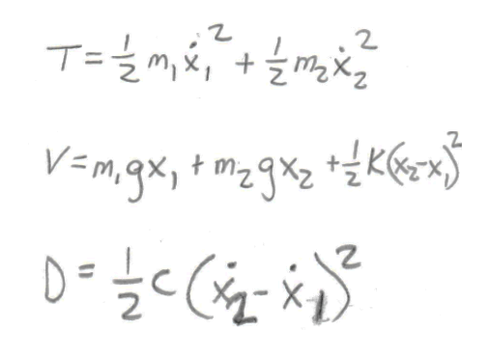
Lagrangian Math
Identify:
Kinetic (T)
Potential (V)
Dampening (D)
x₁
m₁
k
c
x₂
m₂

Slide 6
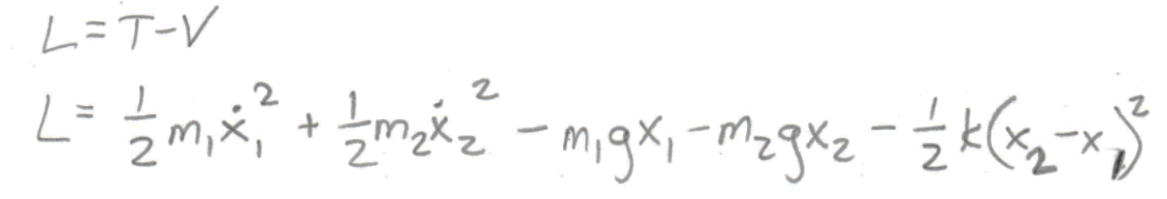
Lagrangian Math
Write out Lagrangian
x₁
m₁
k
c
x₂
m₂

Slide 7
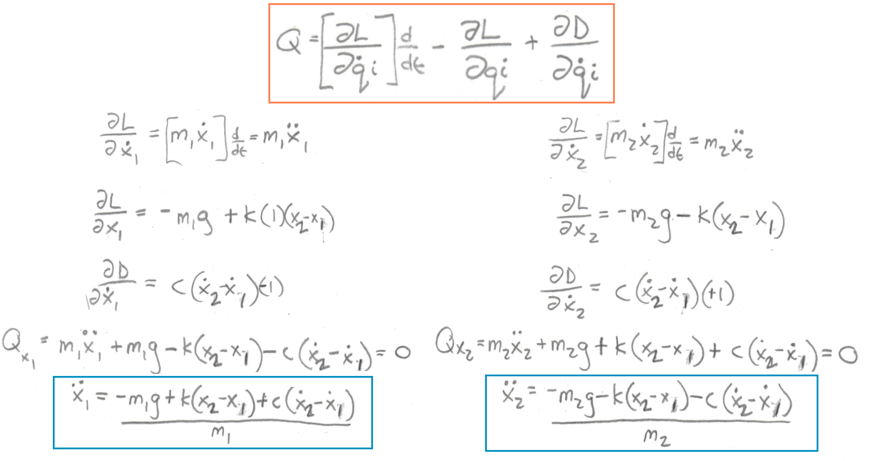
Lagrangian Math
Solve for generalized force for each degree of freedom
x₁
m₁
k
c
x₂
m₂

Slide 8
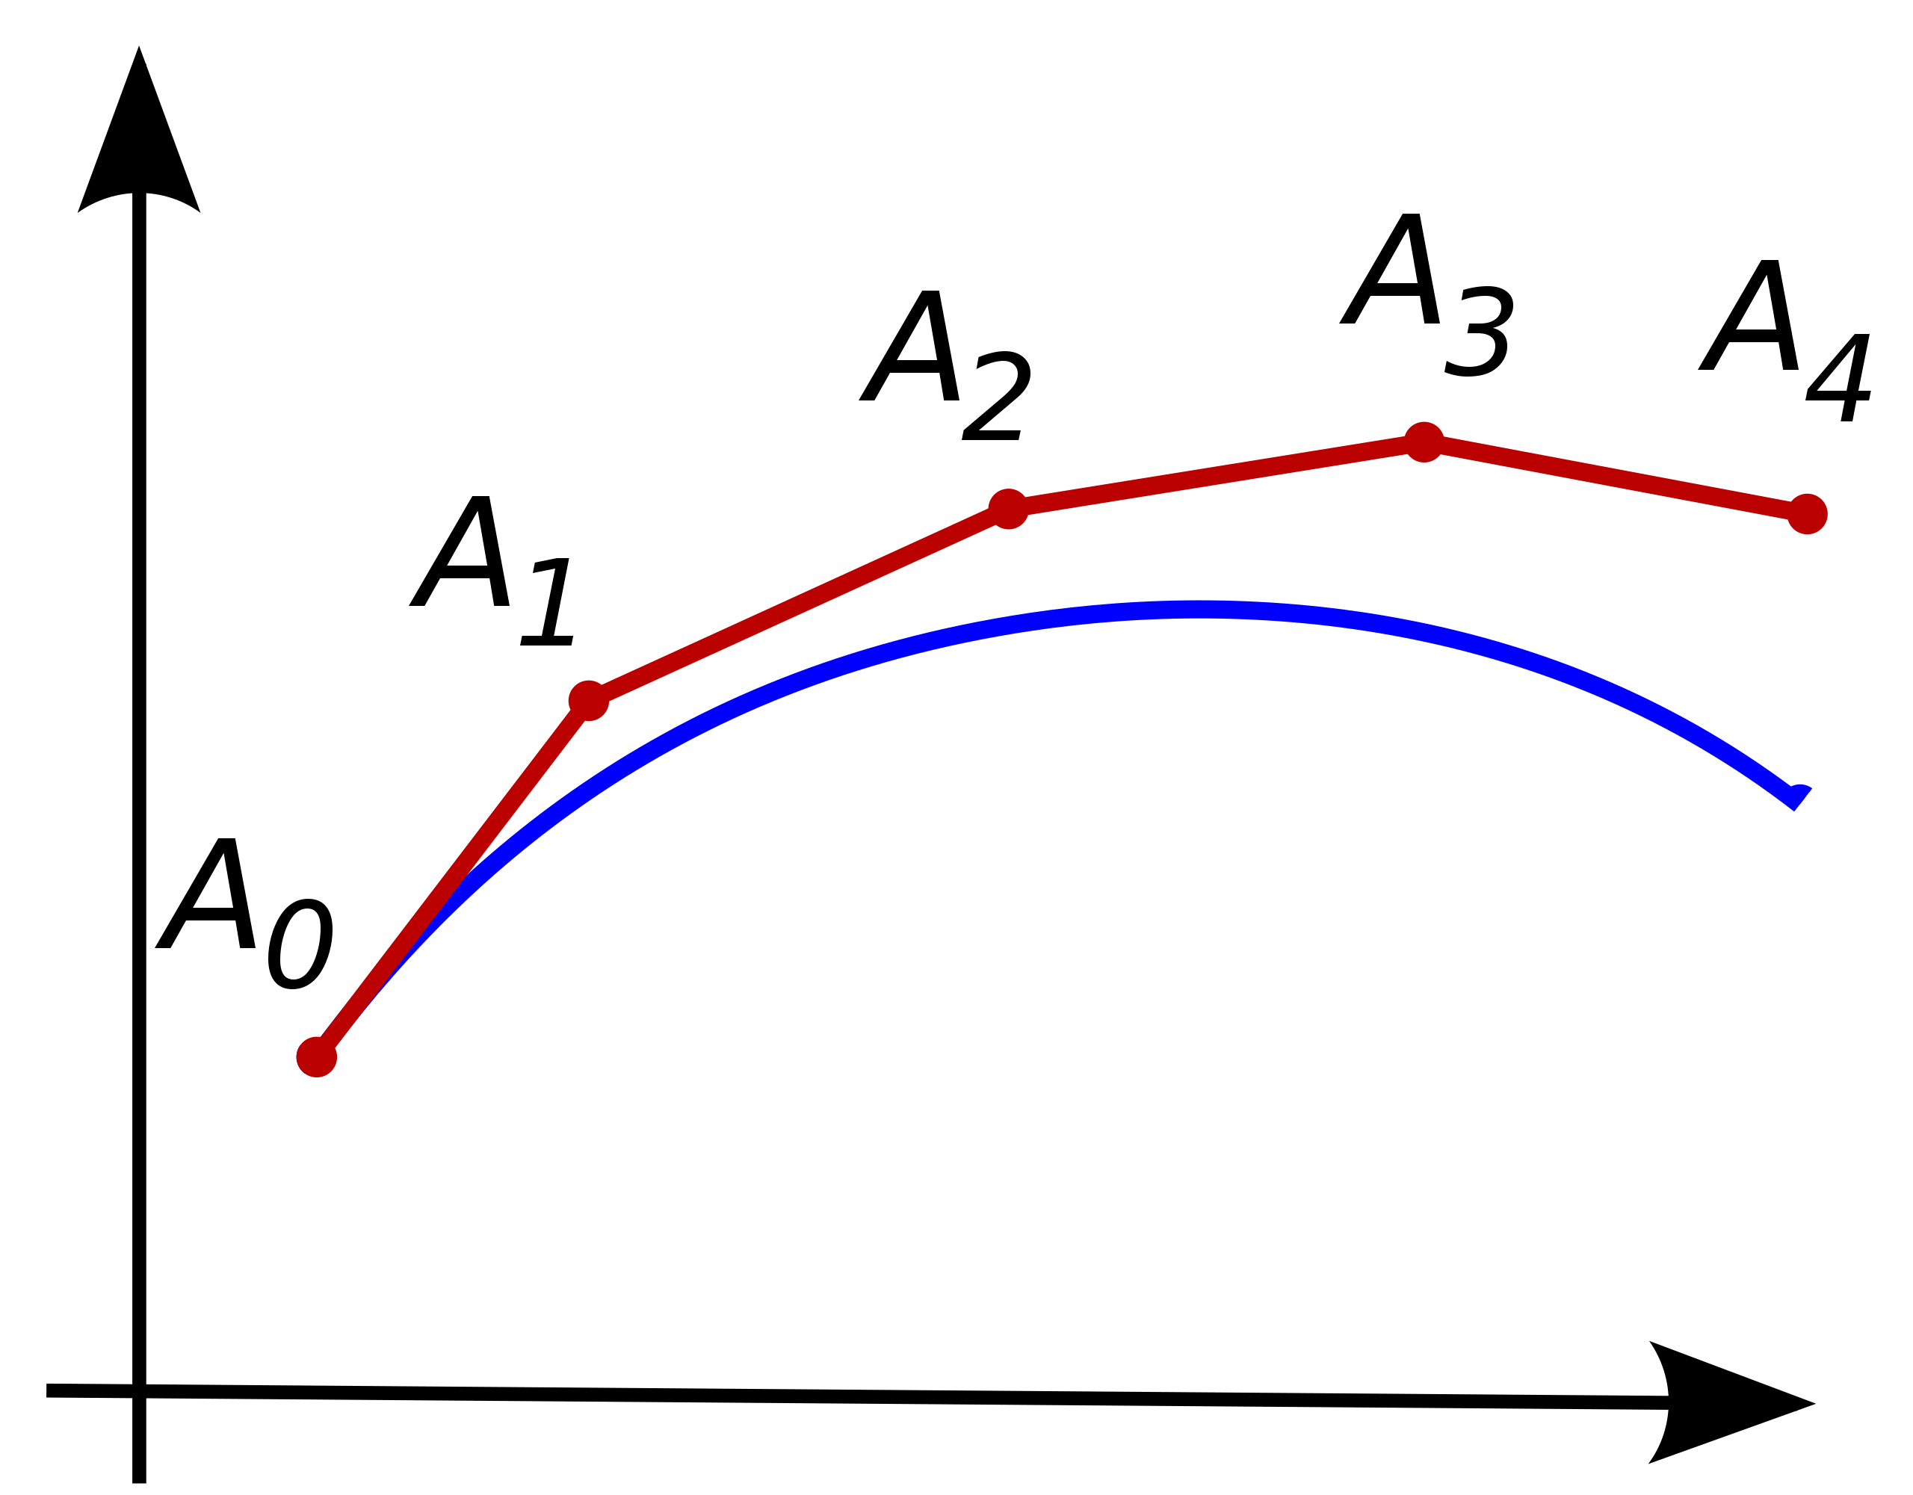
Euler Estimation
New point = last point + (slope @ last point * stepsize)
Equivalent:
Calculate acceleration each mass @ each frame (30fps)
Propagate acceleration down to velocity, position
Draw position
Repeat
From: https://en.wikipedia.org/wiki/Euler_method#/media/File:Euler_method.svg

Slide 9
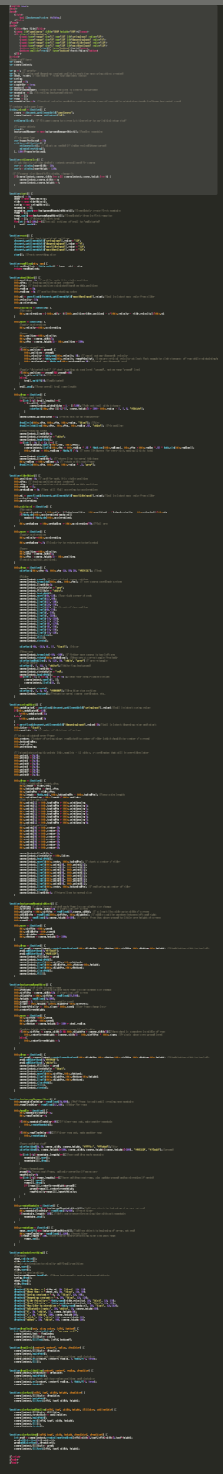

JavaScript Implementation
HTML Canvas Element
JavaScript Objects for:
m1(rider)
m2(wheel)
Spring
Background
Ramps
Objects each frame do:
Move()
Euler sim of Lagrangian math
Calculate accel, propagate down
Draw()
Stylized representation of position
Rotate wheel, adjust spring link spacing, etc.

Slide 10
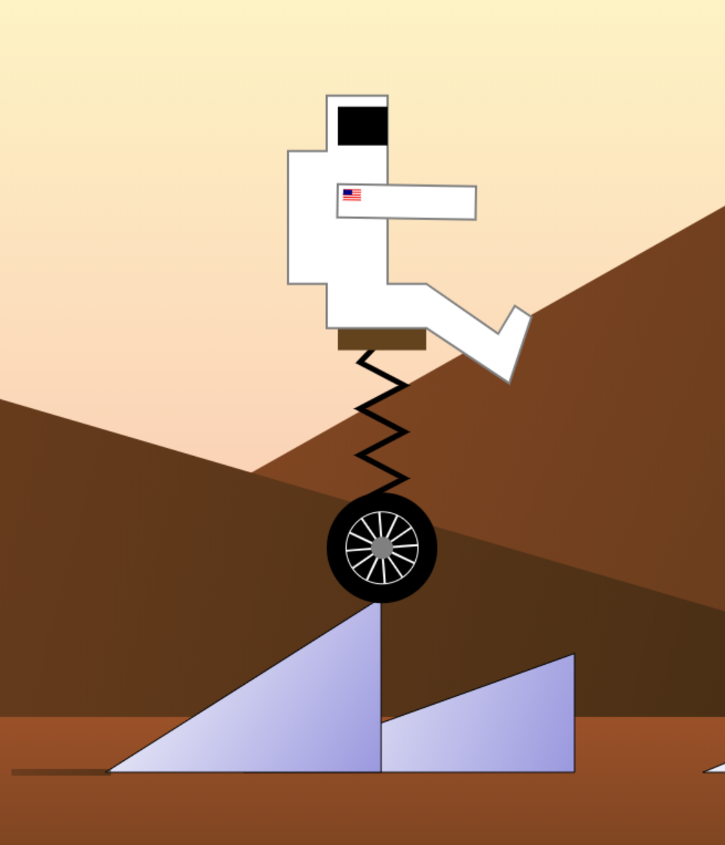
JavaScript Implementation
Constant horizontal speed (5px/frame)
Touching ground (or ramp):
Eliminates negative acceleration of wheel
Eliminates negative velocity of wheel
Touching ramp:
Ensures minimum positive vertical velocity of wheel to reach top on time based on fixed horizontal movement and slope
Equivalent to hitting throttle based on steepness
Other option to maintain “throttle” and slow horizontal speed based on slope
Ramps and mountains randomly generated

Slide 11
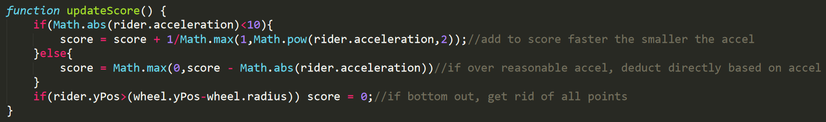
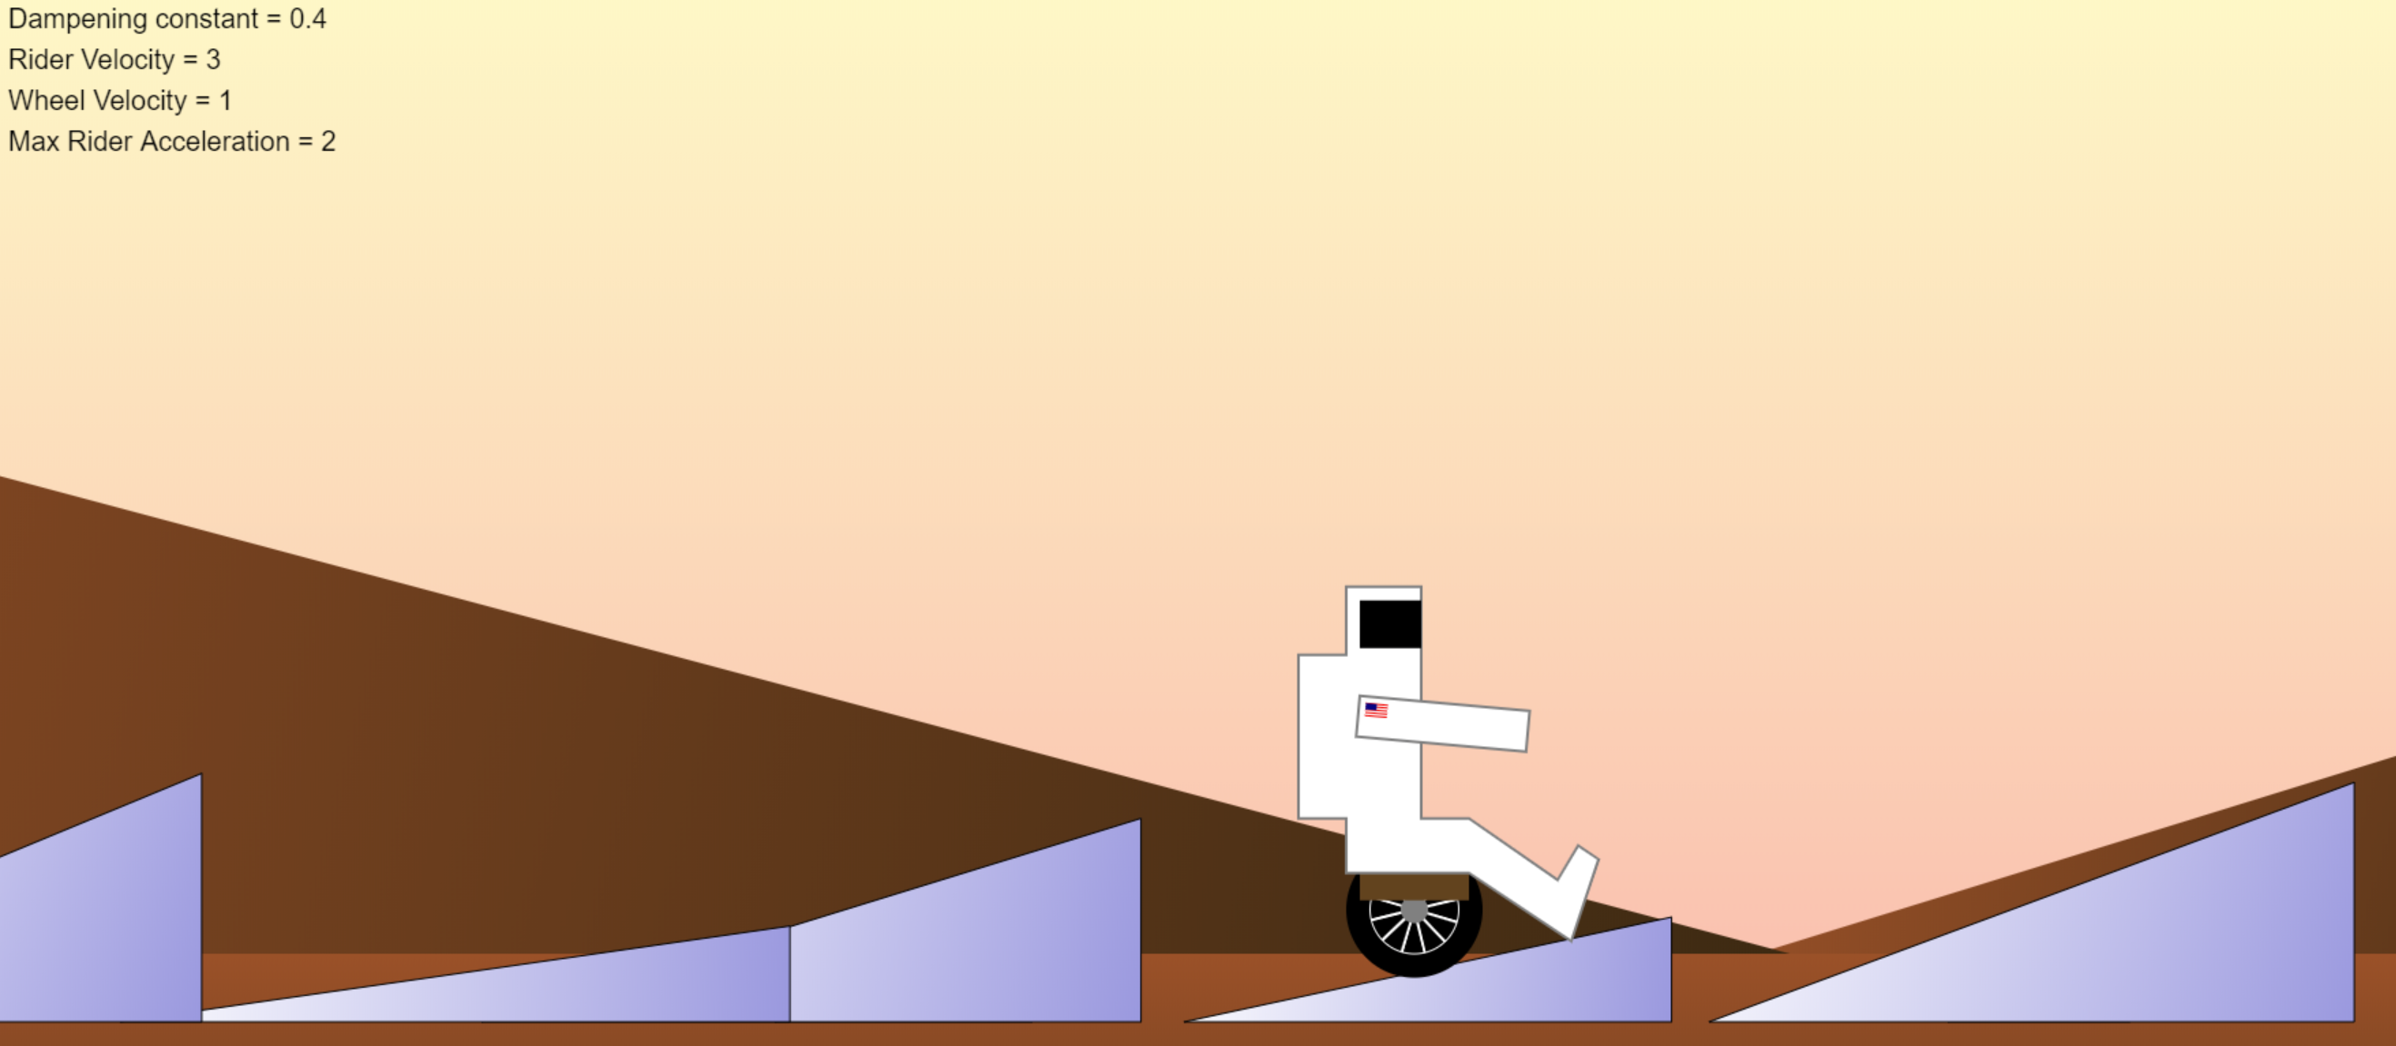

Playing with Variables
Go for max score!
Minimize stress to rider
Avoid bottoming out

